Slide 1
INTRODUCTION:
CHEMICALS IN THE SOCIETY
MODULE 1 - MORNING SESSION I
1-DAY PRESENTATION
www.greenchemistry-toolkit.org

Slide 2
EVERYTHING IS A CHEMICAL
But what does that mean?
  Name everything in the room that is a chemical
  Name everything in the room that is not a chemical
Chemicals are related to:
  Food
  Transportation
  Communication
  Information Technology
  Economy
Notes:
Note: Engage the public from the beginning – ask them to name everything that is/is not a chemical.
Answers may vary. Bottom line of this exercise is that everything is a chemical or has been touched by a chemical.
Make a transition to different areas.

Slide 3
CHEMICALS AND FOOD
Fertilizers
  More food can be grown for the population
  Revolution came with the Haber Bosch process
Pesticides
  Mosquitos carrying deadly diseases can be controlled
  Algal blooms which lead to eutrophication are controlled
Food preservatives
  Longer shelf life leads to population spreading to less favorable places
  In the early 1900s, the Haber-Bosch process allowed incorporation of Nitrogen from the air and lead to population growth.
Image source: Wikipedia
Notes:
Fertilizers – Allowed to grow more food to feed the population. Give example of Haber Bosh process. https://en.wikipedia.org/wiki/Haber_process
Pesticides – Agents which deter, incapacitate, kill, or otherwise discourage pests. Kill mosquitos which transmit deadly diseases like yellow fever and malaria; Controls algal bloom which can lead to eutrophication
Food preservatives – Keep food away from spoiling; Longer shelf life;

Slide 4
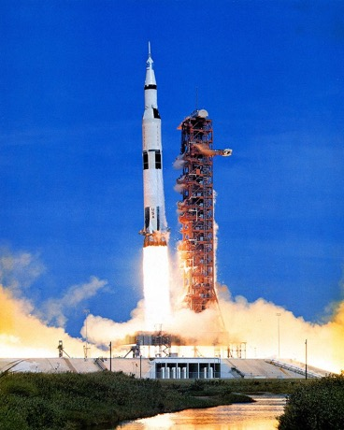
CHEMICALS IN TRANSPORTATION
Gasoline/Diesel
  Fast ground transportation was enabled
Jet Fuel
  Air transportation was enabled
  Globalization and international trade is possible
Rocket Fuel
  Satellites placed on the Earth’s orbit allow communication and navigation
Vulcanized Rubber
  Tires, shoe soles, hoses and conveyor belts can be made
Deicing of plane wings
  Aviation in all conditions is made possible
Apollo 15 launching
Image source: Wikicommons
Notes:
Gasoline/Diesel – fuel enabled fast ground transportation
Jet fuel/rocket fuel – enabled global transportation
Vulcanized rubber – vulcanized rubber has a superior mechanical properties. It’s used in tires, shoe soles, hoses, and conveyor belts.
Deicing of plane wings – enabled aviation in all conditions

Slide 5
CHEMICALS IN COMMUNICATION
Notes:
Note: It is said that the smartphone includes over 75% of the periodic table. In many cases a variety or rare earth metals are used to produce colors in the smartphone's screen.
Question to consider: The current prediction is that by 2010, there will be over 2.8 billion smartphone users. Knowing that the current design requires all the above elements, what does this mean from the sustainability stand point? Chemistry aside, can we afford making phones the way we do? Why/why not?
Possible answer: No – there won’t be sufficient amount of elements to sustain the current (unsustainable) trajectory.

Slide 6

COMMUNICATION AND
INFORMATION TECHNOLOGY
Nanotechnology
  Creation of many materials and devices with applications in nanomedicine (drug delivery), nanoelectronics (computer processors), biomaterials, and personal products (sunscreens)
Displays
  LCD (TV, watches, calculators)
Display device magnified showing a nano structure
Image source: Wikicommons

Slide 7
CHEMICALS IN THE ECONOMY
Chemical industry sector
  Total pharmaceutical revenue had reached $1 trillion in 2014
Petrochemicals
  Global market is estimated to reach $791 billion by 2018
Consumer products
    Most products that we see, touch, and feel are petroleum based
Job creation
  Robust selection of consumer/personal care products leads to job creation and increase in GDP
    Approximately 1 million direct jobs from chemicals industry
    Approximately 6 million indirect jobs

Slide 8
CHEMICALS AND UNINTENDED CONSEQUENCES
Chemicals can also negatively impact the society.
HOW?
Notes:
While chemicals drive health, food, transportation, communication industries, they can also impact society in a negative way and lead to unintended and unpredicted consequences.

Slide 9
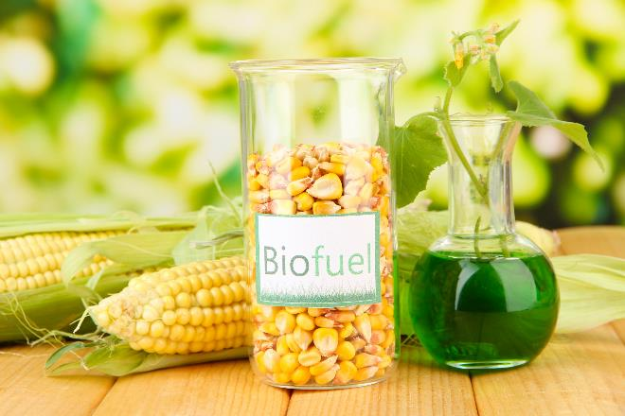
UNINTENDED CONSEQUENCES
Biofuels made from corn that compete with food, feed, and land use.
Biofuels made from corn.
Image source: Adobe Stock
Notes:
Biofuels, specifically made from corn, an abundant vegetable, seems like a great idea. But when the corn needs land, fertilizers, water, and infrastructure for harvesting, then production of biofuel becomes unintended consequence.

Slide 10
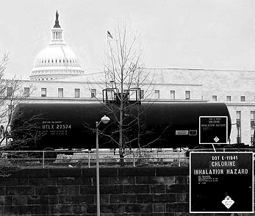
UNINTENDED CONSEQUENCES
Purifying water with acutely lethal substances.
Chlorine transported in Washington D.C.
Notes:
Everyone should have an access to clean water. What if to get purified water, acutely lethal substances like chlorine are used?

Slide 11
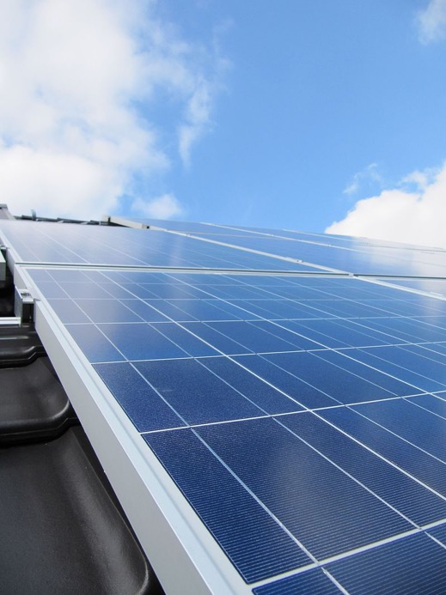
UNINTENDED CONSEQUENCES
Renewable energy through the use of precious, rare, toxic metals in photovoltaics.
Solar panel installed on the roof of the building
Image source: Wikipedia
Notes:
Energy which does not rely on petroleum but rather on solar can be a good thing. But what if the solar panel technology relies on rare earth and precious metals?

Slide 12
OTHER ENVIRONMENTAL CHALLENGES
Population
Energy
Global Change
Resource Depletion
Food Supply
Toxics in the Environment
Notes:
There are other environmental challenges we as society have to think about when considering chemicals.

Slide 13
POPULATION TRENDS
Source: U.N. World Population Prospects, 2000 Revision
Population growth in developing countries is predicted to reach 7.8 billion by 2050.
G-10 countries remain the same.
Notes:
The population growth happens mostly in developing countries (G77). By 2050, we will most likely reach 9.5 billion.
These countries need biggest support and attention.

Slide 14
QUALITY OF LIFE DILEMMA
Empirical data shows that increased quality of life correlates with sustainable population control
Increased quality of life, however, has historically resulted in increased damage to the biosphere and the earth’s ability to sustain life
Notes:
To maintain the quality of life with the increased population, big changes need to happen.

Slide 15
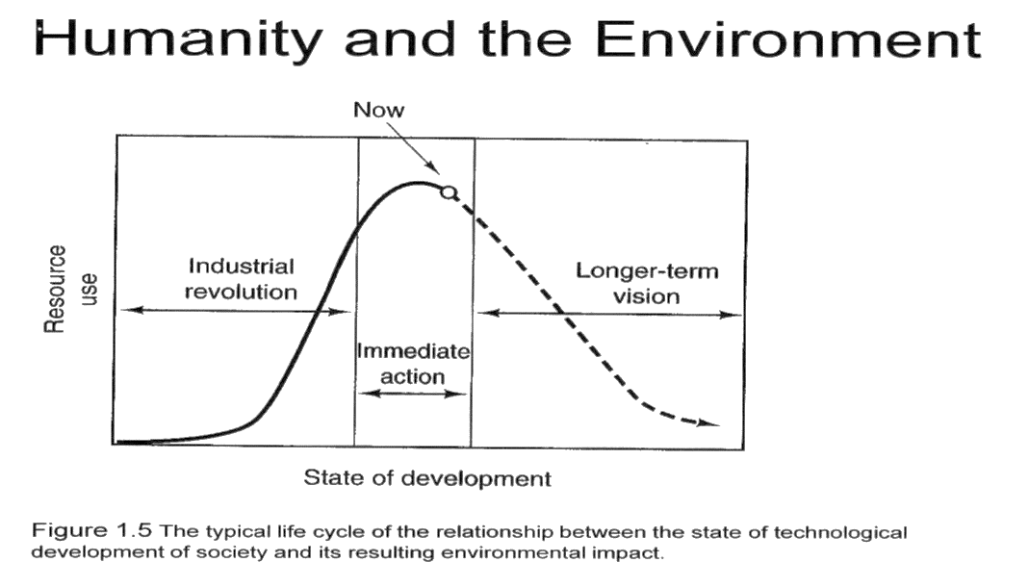
IMPACT OF DEVELOPMENT ON THE ENVIRONMENT
Notes:
9
As of now, we as population live very unsustainably. To maintain our current life, we will need more and more resources, which with increasing population is not possible. The graph shows the relationship between the state of technological development of the society and environmental impact. Currently we are using maximum resources and not considering the future.

Slide 16
POPULATIONAL CHALLENGE
The challenge: How to increase quality of life while minimizing detrimental effects to human health, the environment, and the biosphere
The solution: Green Chemistry and Green Engineering provide a mechanism to address this challenge in very real terms

Slide 17
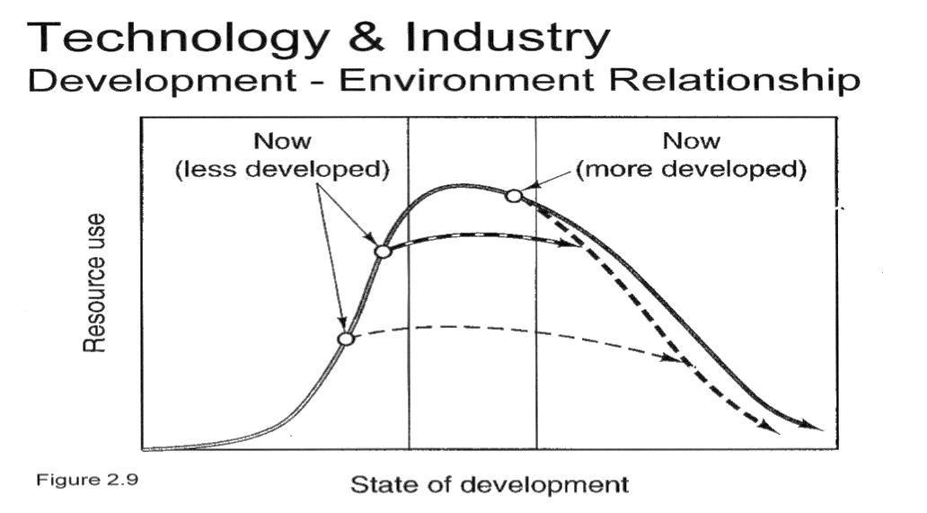
EFFICIENCY THROUGH SCIENCE AND TECHNOLOGY
Notes:
Advances in technology (and green chemistry) allow to reduce the resource use and maintain the quality of life even with increasing population.

Slide 18
“The great enemy of the truth is very often not the lie -- deliberate, contrived and dishonest
but the myth -- persistent, persuasive and realistic.”
John F. Kennedy
Notes:
A famous quote by JFK.

Slide 19
OTHER ENVIRONMENTAL CHALLENGES
Population
Energy
Global Change
Resource Depletion
Food Supply
Toxics in the Environment

Slide 20
ENERGY
The vast majority of the energy generated in the world today is from non-renewable sources that damage the environment:
  Carbon dioxide and greenhouse gases
  Depletion of resources
    Rare earth metals, fossil fuels
  Effects of mining, drilling
    Contamination of streams, lakes and ground water by fracking fluid or Sulphur ores
  Toxics
    Separation agents like benzene, toluene and xylene (BTX) which are shown to be carcinogenic.

Slide 21
GROWING ENERGY CONSUMPTION
Energy use has approximately doubled in the past 30 years
Notes:
Energy consumption of growing due to our lifestyle and the new technological demands.

Slide 22
WHAT TYPE OF ENERGY FUTURE?
Sources: DOE/EIA-Word energy projection system
Notes:
Oil and coal are still dominant sources of energy. Renewable materials are present but in minority.

Slide 23
ENERGY
Green Chemistry will be essential in both:
  Developing the alternatives for energy generation (photovoltaics, hydrogen, fuel cells, biobased fuels, etc.)
  Continuing the path toward energy efficiency with catalysis and product design at the forefront

Slide 24
OTHER ENVIRONMENTAL CHALLENGES
Population
Energy
Global Change
Resource Depletion
Food Supply
Toxics in the Environment

Slide 25
GLOBAL CHANGE
Concerns for climate chaos, oceanic temperature, stratospheric chemistry, and global distillation can be addressed through the development and implementation of green chemistry technologies

Slide 26
TEMPERATURE CHANGE
Source: http://www.sustainablescale.org/
Notes:
2
Temperature change in 1000 years. Temperate fluctuates +/- 0.2 C. The most dramatic temperature change happened since the industrial revolution in 1960 until recent times. The current numbers (not shown here) indicate that we will cross 1.5 degree Celsius in 10 years.
For the description what that means see here: http://globalwarming.berrens.nl/globalwarming.htm

Slide 27
CARBON DIOXIDE, METHANE AND NITROUS OXIDE CONCENTRATIONS OVER THE PAST 1,000 YEARS
Notes:
Carbon dioxide is on the rise too.

Slide 28
OTHER ENVIRONMENTAL CHALLENGES
Population
Energy
Global Change
Resource Depletion
Food Supply
Toxics in the Environment

Slide 29
RESOURCE DEPLETION
Due to the over utilization of non-renewable resources, natural resources are being depleted at an unsustainable rate.
Examples of depleting resources: precious metals, fossil fuels
These are used to support of our current life style, economy, etc

Slide 30
RESOURCE DEPLETION
Renewable resources can be made increasingly viable technologically and economically through green chemistry:
  Biomass
    Algae for fuel, lignin for platform chemicals
  Nanoscience & technology
  Transformations with visible light
    Light rather than solvents
  Carbon dioxide as feedstock
    In plastics
  Chitin as feedstock
    In packaging
  Waste utilization
    By biodegradation

Slide 31
OTHER ENVIRONMENTAL CHALLENGES
Population
Energy
Global Change
Resource Depletion
Food Supply
Toxics in the Environment

Slide 32
FOOD SUPPLY
While current food levels are sufficient, distribution is inadequate
Agricultural methods are unsustainable
Advances in future food production intensity is needed

Slide 33
INCREASE IN GRAIN PRODUCTION
There is a growing demand in grain production in developing, industrialized and transition countries.
Source: FAO 1989-2000
Notes:
8

Slide 34
USE OF PESTICIDES
Notes:
3

Slide 35
FOOD SUPPLY
Green chemistry is developing:
  Pesticides which only effect target organisms and degrade to innocuous by-products
  Fertilizers and fertilizer adjutants that are designed to minimize usage while maximizing effectiveness
  Methods of using agricultural wastes for beneficial and profitable uses

Slide 36
OTHER ENVIRONMENTAL CHALLENGES
Population
Energy
Global Change
Resource Depletion
Food Supply
Toxics in the Environment

Slide 37
TOXICS IN THE ENVIRONMENT
Substances that are toxic to humans, the biosphere and all that sustains it, are currently still being released at a cost of life, health and sustainability.

Slide 38
BODY BURDEN
In 2000-2001 the study showed that human body includes 148 xenobiotic.
Of the chemicals found:
  76 suspect carcinogens in humans or animals,
  94 are identified neurotoxins, and
  79 are linked to reproductive/developmental toxicity.
The synergistic effects of these chemicals in combination has not been studied.
One of Green Chemistry’s greatest strengths is the ability to design for reduced hazard.

Slide 39

THANK YOU!
QUESTIONS?
This training material was developed in close collaboration with the Center for Green Chemistry and Green Engineering at Yale University.
www.greenchemistry-toolkit.org

